Slide 1
‘Simon Says’, A Memory Game
(Arduino module)
By Viaswat Shastry
ESP4T 2016
Electrical and Computer Engineering
College of Engineering and Applied Sciences
University of Wyoming

Slide 2
Goal
The idea is to re-create the ‘Simon Says’ game for the Arduino using techniques that we have previously learned.
How: First the Arduino will light up LEDs in a random fashion. The objective of the level is to recreate this pattern using switch buttons.
The first level will only have one LED light up, the second will have two and so on.
To win the game, the user must finish ALL 10 levels. (with a 10 LED sequence in the end!)
And it can be played any number of times!

Slide 3
Overview
It is a game that tests the short term memory capacity of the brain.
As we build the game from scratch we will look at some procedural programming concepts and elementary circuit design.
Rating: (0 being LOW and 5 being HIGH)
(NOTE: All components that are required for this game is available in the provided Arduino kit)

Slide 4
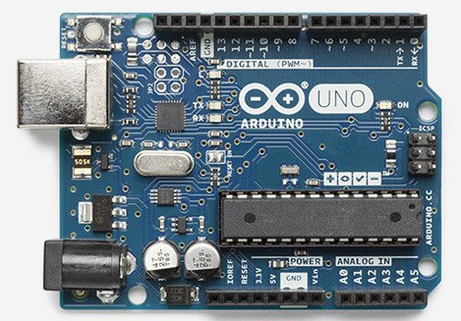

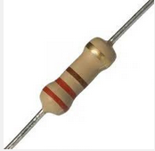


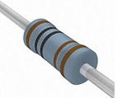
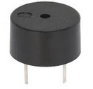
Components Required
0. ONE Arduino board
ONE Breadboard
THREE 220Ω resistors
THREE (preferably) different colored LEDs
MANY Jumper wires!
THREE 1kΩ resistors
ONE Buzzer (the one with a green underbelly!)

Slide 5
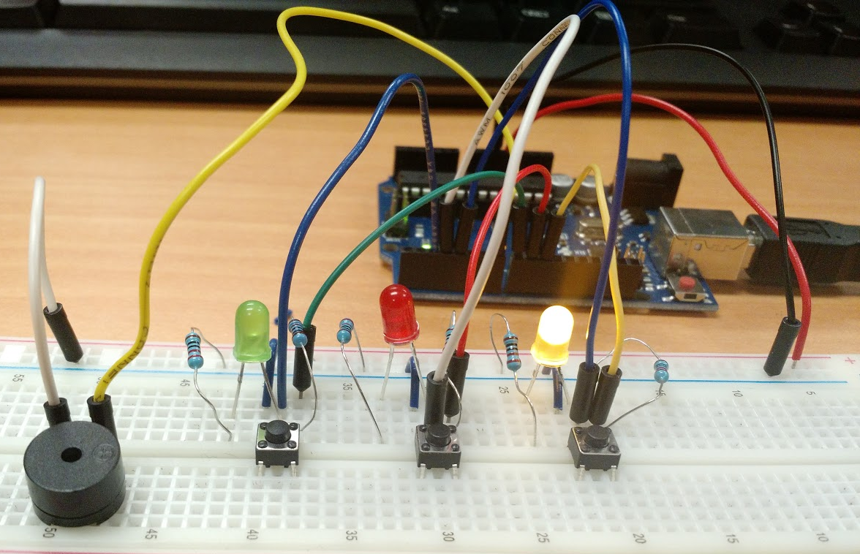
Final Look
The project should look something like this at the end, with a few minor differences in wiring of course:

Slide 6
Let’s Get Started!
(P.s. Make sure you have all your components in order)

Slide 7
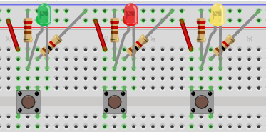
Step 1. LEDs and Buttons
First let us connect the LEDs and Switch buttons to the breadboard.
The resistors connected to the LED are 220 Ω and the ones connected to the push button are 1 kΩ.

Slide 8
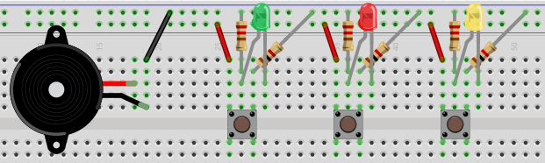
Step 2: Connect the Buzzer
Now we will place the buzzer on the breadboard.
(The side with the ‘+’ symbol on the buzzer is the one with the red wire)

Slide 9
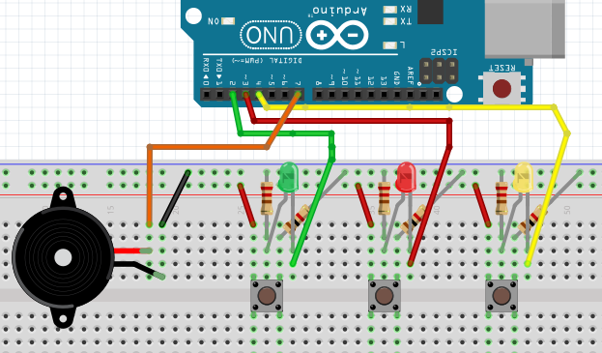
Step 3: Connect to the Arduino (Part 1)
We will now connect the LEDs and the Buzzer to the Arduino.
Pin 2 – Green LED (green wire) Pin 7 – Red wire of Buzzer (‘+’ side) (orange wire)
Pin 3 – Red LED (red wire) Pin 4 – Yellow LED (yellow wire)

Slide 10
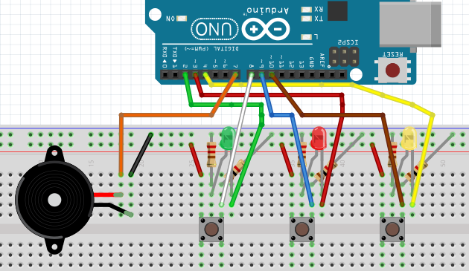
Step 4: Connect to the Arduino (Part 2)
We now need to connect the push buttons to their respective ports on the Arduino.
Pin 8 – Button corresponding to Green LED (white wire)
Pin 9 – Button corresponding to Red LED (blue wire)
Pin 10 – Button corresponding to Yellow LED (brown wire)

Slide 11
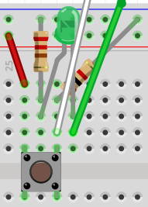
Step 4.5: A Closer Look…
Each of your LEDs need to be connected in the same fashion.
Switch button:
One leg goes to the +5V railing and the other leg is connected to a 1kΩ resistor and Pin 8 on the Arduino.
LED:
One leg is connected to a 220Ω resistor that is going to GND while the other leg is connected to the jumper going to the Pin 2 of the Arduino.
(NOTE: This is only for the GREEN LED setup. Pin numbers will vary for the other ones)
Pin 8
Pin 2
GND
+5V

Slide 12
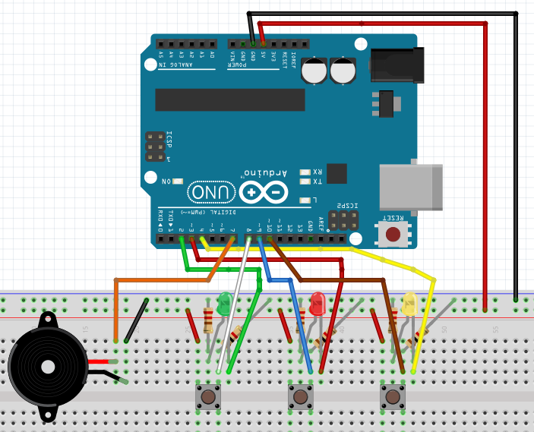
Step 5: Connect to the Arduino (Part 3)
This is the final leg of the circuit building process. We need to connect the +5V and GND to the board without which nothing will work.
The TWO wires on the extreme right end of the figure.
+5V – Red (+) railing (red wire)
GND – Blue (-) railing (black wire)

Slide 13
Step 6: Circuit Check!
You should have a total of NINE (9) wires coming out of the ports in your Arduino.
ONE from +5V and ONE from GND going into their respective railings of RED and BLUE lining.
THREE consecutive wires from pins 2, 3 and 4 going into a leg of the Green, Red and Yellow LED.
The other leg of the LED should be going into one side of a 220 Ω resistor.
ONE wire going from pin 7 to the ‘+’ side of the Buzzer.
THREE consecutive wires going from pins 8, 9 and 10 into one leg of the switch button.
The other leg of the switch button should be connected to the RED railing on the bread board.

Slide 14

Final Schematic
(It is NOT recommended that you start building your circuit based on this. The ideal procedure would be to follow the previous steps in order and then refer to this at the end.)

Slide 15
Step 7: Programming the game
We have completed the hardware aspect of the game so we move onto the software aspect.

Slide 16
Step 8: Opening the program
We now need to open the program that you have downloaded in the Arduino IDE.
To do this, first go to File (upper left corner) → Open… and click on that option.
Or press Ctrl + O (Command + O in Mac) to get to the same option.
You should be directed to new window which allows you to browse your file system.
Navigate through your file system to find the Arduino file and select it.
Then ‘Open’ the file and you will be taken to an Arduino window with the program in it.

Slide 17
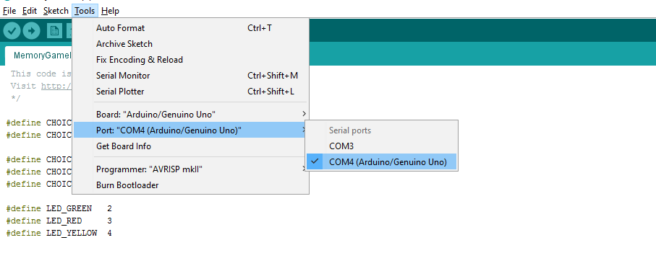
Step 8: Choosing the right COM Port
Before we can start on this step, ensure that your Arduino is connected to your laptop/computer.
This means you should have a cable with one end in the Arduino and the other in the USB port of your system.
To select the right COM port, follow this screenshot:
Next to your COM port it should say ‘(Arduino/Genuino UNO)’.
(You may have a different COM number, that is fine)

Slide 18

Step 9: Uploading program to the Arduino
We now have to put the program onto the Arduino so that we can play game.
The simplest way is to click the right arrow button on the taskbar of the Arduino IDE
The terminal at the bottom of your IDE should now say ‘Uploading…’ and then ‘Done Uploading.’
If so, your program is on the board and you can start playing the game.

Slide 19
Errors while Uploading
Ignore this slide if you could upload onto the board successfully.
Most of the time, the problem seems to be with finding the right COM port.
Follow the steps as described in the previous slide to choose the right COM port.
Try unplugging the Arduino and plugging it back in again.
For syntax errors, follow C code style of syntax as shown in the workshops and implement any suggested changes.
Look out for unmatched parenthesis, brackets, and missing semicolons.
Google any errors that can’t be solved from the above methods.

Slide 20
Step 11: Enjoy the game!
Follow the instructions given in the code to play the game. Have fun!

Slide 21
Step 12: Suggested changes
The game does get boring after a while.
To spice it up a bit, you can make it more difficult.
Increase the number of levels required to complete the game.
This can be done by changing the variable LEVELS_TO_COMPLETE
Decrease the amount of time given to the user to enter his option.
This can be done by changing the variable ENTRY_TIME_LIMIT

Slide 22
Step 12: Suggested Changes (Part 2)
Increase the number of options to FOUR (4)
This will require ONE more LED, ONE more pushbutton and TWO extra resistors.
Wiring this extra LED and push button in will be the same as for the previous three.
When connecting to the Arduino, pin 5 can connect to the LED while pin 11 can connect to the push button.
The resistors will go into the same slots as before.
There will be a few minor changes in the program.
The variable NO_OF_LEDS should be changed to 4 obviously.
The new LED of a different color will need a new variable CHOICE_<new color> defined as 3
The pin numbers to the new LED and push button will have to be defined as 5 and 11 respectively
In the setup() function, we will have to set these pins to be INPUT_PULLUP and OUTPUT
There are a few more changes in the rest of the program that are quite intuitive.
Sections in the code that repeat a certain procedure for the three LEDs should be modified (added to) to accommodate the fourth LED.

Slide 23
Bonus: Code Snippets
The following slides will contain explanations to certain excerpts of the code.

Slide 24
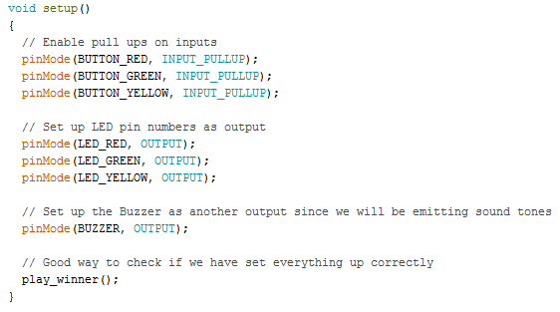
The setup() function
The setup() function contains code that only needs to be executed once during the whole program. So we declare the different peripherals we will be using, in this function.
Since we are using the push button in the pullup configuration we will be declaring that in pinMode.
We will be using the LEDs as an output device to indicate to the user.
We will also be using the buzzer as an output device to give the user audio cues to aid in playing the game.
At the end, we will play a sequence of lights to indicate that the setup has occurred correctly.

Slide 25
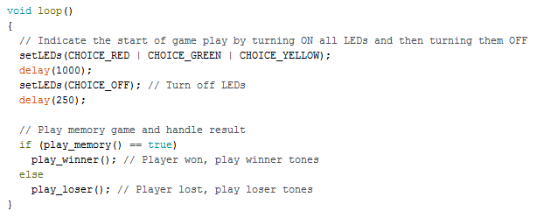
The loop() function
In the loop() function exists code that needs to be executed repeatedly for the game to continue.
Every time the Arduino is reset we need to restart the game. So we do that by flashing all the LEDs ON and OFF to signal the user.
Then we do a simple check to see if the player has won the memory game, if they have the function play_memory() will return true and we play the sound track to indicate a win. If not, we play the loser audio track. Both of these will be accompanied with a visual cue of LEDs lighting up.

Slide 26
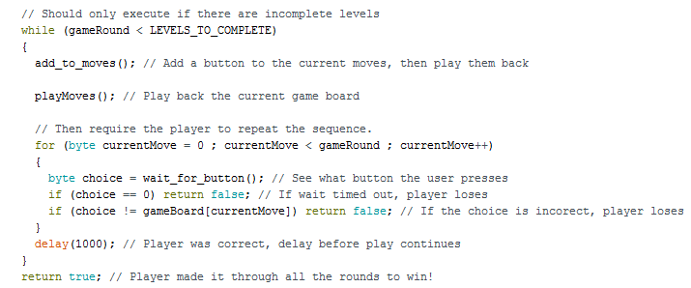
The play_memory(void) function
First we do a check to see if there are any remaining levels in the game. The following block of code will only execute if that is true.
Then to level up, we will add an extra LED to the sequence to make it tougher.
Following this, we will play the LED sequence back to the user.
Then we check for the user input to each LED blink. The variable choice will store what button number was pressed. We will then compare it to what the current button is to see if it is correct.
And this happens for each and every LED flash till the end of the sequence.
If all of the user’s options are correct, we will return true to the loop() function signifying that the game is now won.

Slide 27
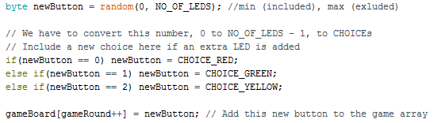
The add_to_moves(void) function
This purpose of this function is to add a new LED to the existing sequence during level up. And this has to be a randomly chosen LED.
First we use the Arduino’s random function to get a number between 0 and the NO_OF_LEDS – 1 and store it in the variable newButton.
Then we check to see what the Arduino spits out and match it to an LED choice.
Since we now have one more LED in our sequence we have to increment the number of the moves in the game and assign newButton to the latest one.

Slide 28
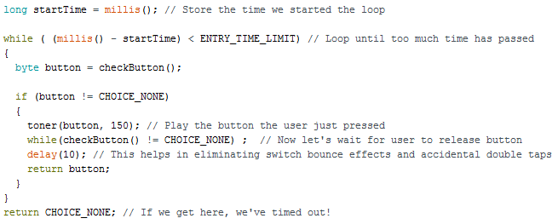
The wait_for_button(void) function
As the name suggests this function does nothing but wait for a button to be pressed and then pass it on.
In the first line we start an in-built timer as soon as the function starts and we store the start time in a variable called startTime.
Then we check difference between the current time and the startTime to see if too much time has elapsed. If it has then we exit the loop and don’t record the user’s button press.
If it hasn’t then we enter the while loop and wait for a button press. This button press will be stored in the variable button.
When that is done we play back the sound of the button the user just pressed for audio feedback.
We then delay for some time in the case of switch bounce or a double tap and return the value of the button (i.e. 8, 9 or 10) pressed.

Slide 29

The checkButton(void) function
Once again this function does exactly what it says. It checks to see if a button has been pressed and if so, which button has been pressed.
This is a simple function, in which we use Arduino’s digitalRead function to see if a button was pressed.
Since the button is in INPUT_PULLUP mode, a ‘1’ value is recorded as a button push. So if we see a ‘1’ on pin 10, we send back CHOICE_YELLOW since it corresponds to the Yellow LED and so on.
We also have an option for the eventuality that there is no button push. We return CHOICE_NONE then.

Slide 30
The rest of the code…
The rest of the code contains toner and sound functions.
These functions are an extra functionality added to the game. If they are removed the game will run exactly the same way, without audio cues of course.
These functions contain the sound bytes that are played when a game is won or lost. And the tones that are played for every push button.
The crux of the code required for the regular functioning of the game is before this part. The logical statements required to make decisions, hardware-software interaction, visual playback and so on.
Comments are available in the code file and you are encouraged to look at it!

Slide 31
Thank you!
The end.

